Slide 1

Events

Slide 2
Agenda
Onblur
On change
Onclick
Form related events
Lord events
Key events
Mouse events
On dblclick
On beforeunload
On can play

Slide 3
HTML Event Attributes
HTML has the ability to let events trigger actions in a browser, like starting a JavaScript when a user clicks on an element.
Some of the events are
Window Event Attributes
Form Events
Keyboard Events
Mouse Events
Drag Events
Clipboard Events
Media Events
Misc Events

Slide 4

Onblur

Slide 5
HTML onblur Event Attribute
The onblur attribute fires the moment that the element loses focus.
Onblur is most often used with form validation code (e.g. when the user leaves a form field).
The onblur attribute is the opposite of the onfocus attribute.

Slide 6
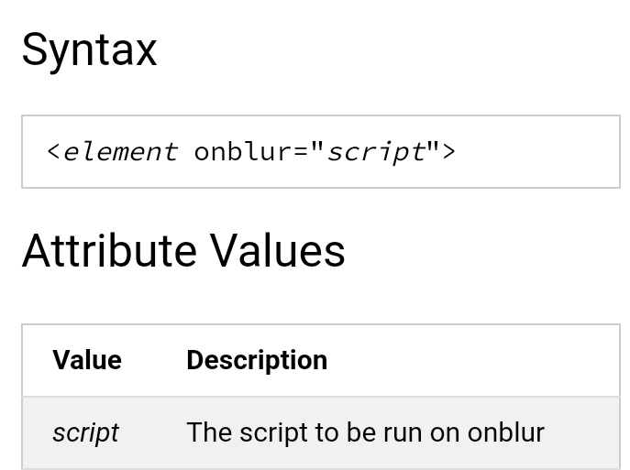

Slide 7
<!DOCTYPE html>
<html>
<body>
Enter your name: <input type="text" name="fname" id="fname" onblur="myFunction()">
<p>When you leave the input field, a function is triggered which transforms the input text to upper case.</p>
<script>
function myFunction() {
var x = document.getElementById("fname");
x.value = x.value.toUpperCase();
}
</script>
</body>
</html>

Slide 8
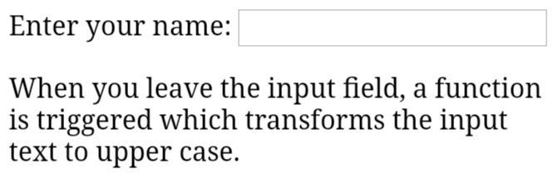

Slide 9

On change

Slide 10
The onchange attribute fires the moment when the value of the element is changed.
This event is similar to the oninput event.
The difference is that the oninput event occurs immediately after the value of an element has changed, while onchange occurs when the element loses focus.
The other difference is that the onchange event also works on <select> elements.

Slide 11
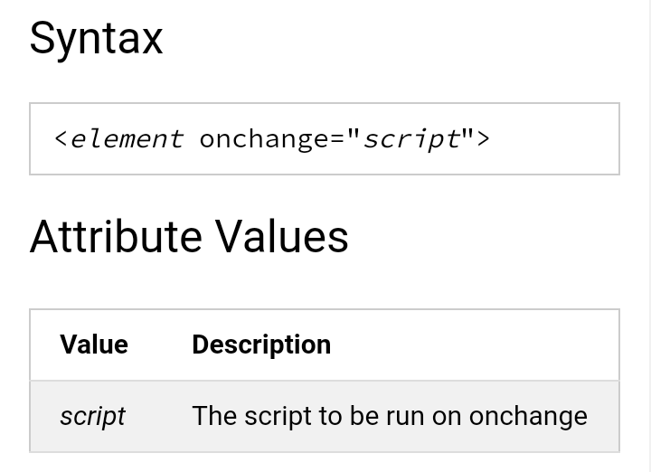

Slide 12
<!DOCTYPE html>
<html>
<body>
<p>Select a new car from the list.</p>
<select id="mySelect" onchange="myFunction()">
<option value="Audi">Audi
<option value="BMW">BMW
<option value="Mercedes">Mercedes
<option value="Volvo">Volvo
</select>
<p>When you select a new car, a function is triggered which outputs the value of the selected car.</p>
<p id="demo"></p>
<script>
function myFunction() {
var x = document.getElementById("mySelect").value;
document.getElementById("demo").innerHTML = "You selected: " + x;
}
</script>

Slide 13
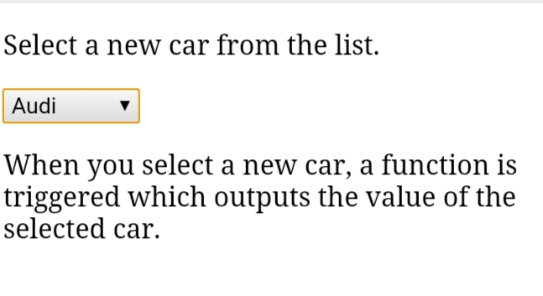

Slide 14

On click

Slide 15
The onclick attribute fires on a mouse click on the element.

Slide 16
<!DOCTYPE html>
<html>
<body>
<button onclick="myFunction()">Click me</button>
<p id="demo"></p>
<p>A function is triggered when the button is clicked. The function outputs some text in a p element with id="demo".</p>
<script>
function myFunction() {
document.getElementById("demo").innerHTML = "Hello World";
}
</script>
</body>
</html>

Slide 17
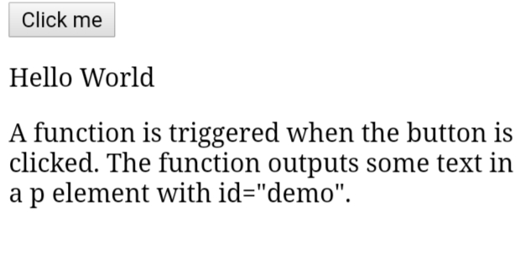

Slide 18

Form related events

Slide 19
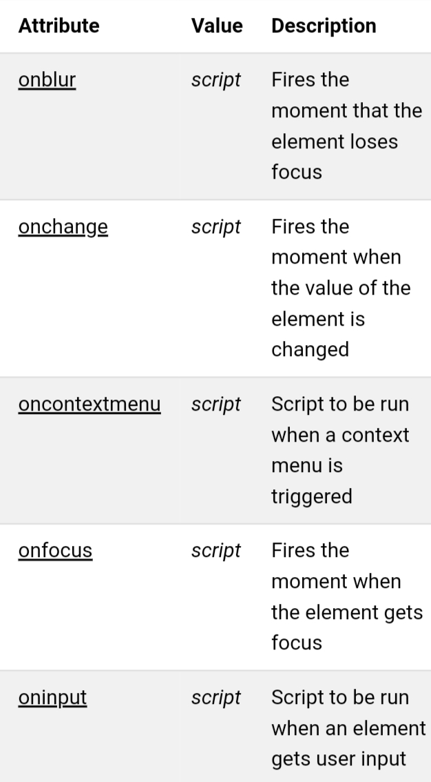
Form Events

Slide 20
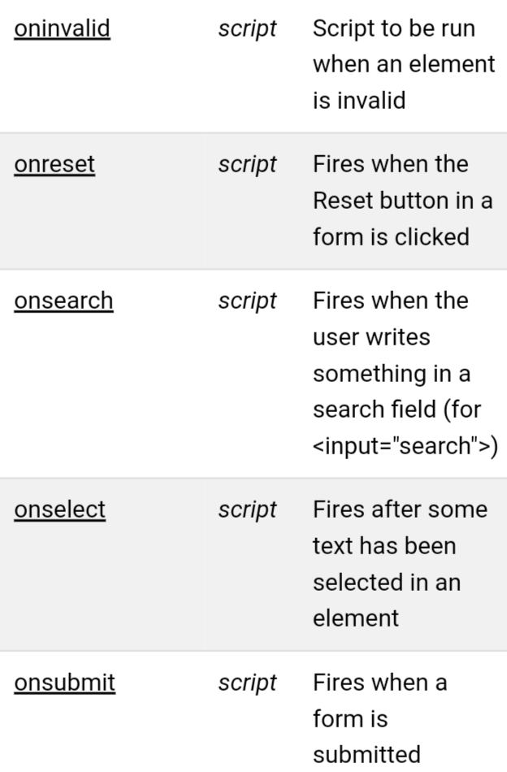

Slide 21

Onload events

Slide 22
The onload event occurs when an object has been loaded.
onload is most often used within the <body> element to execute a script once a web page has completely loaded all content (including images, script files, CSS files, etc.).
The onload event can be used to check the visitor's browser type and browser version, and load the proper version of the web page based on the information.

Slide 23
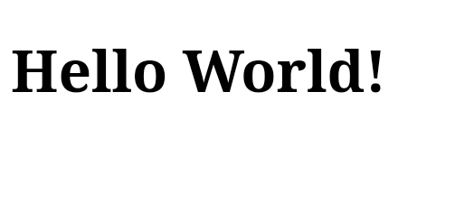
<!DOCTYPE html>
<html>
<body onload="myFunction()">
<h1>Hello World!</h1>
<script>
function myFunction() {
alert("Page is loaded");
}
</script>
</body>
</html>

Slide 24

Key events

Slide 25
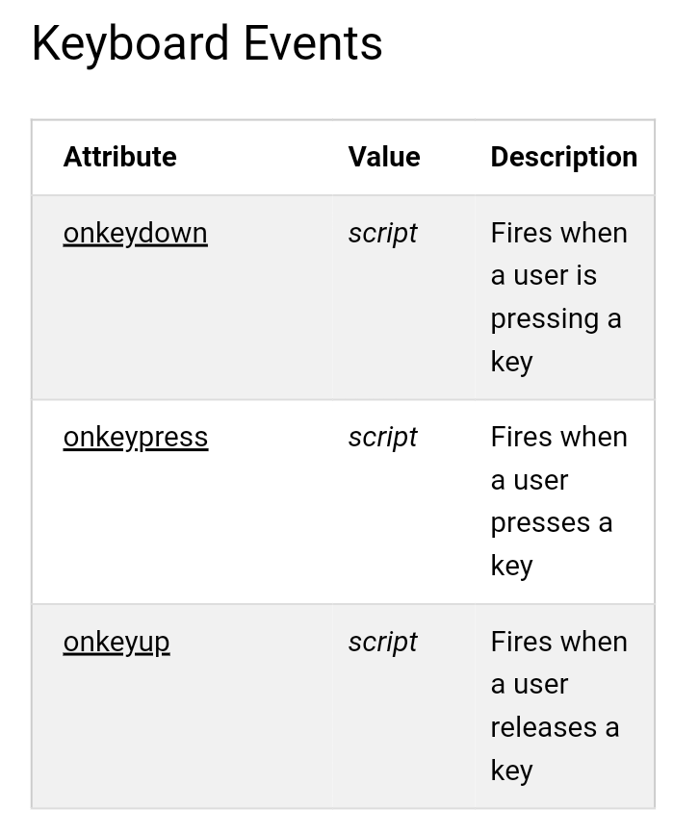

Slide 26

Mouse events

Slide 27
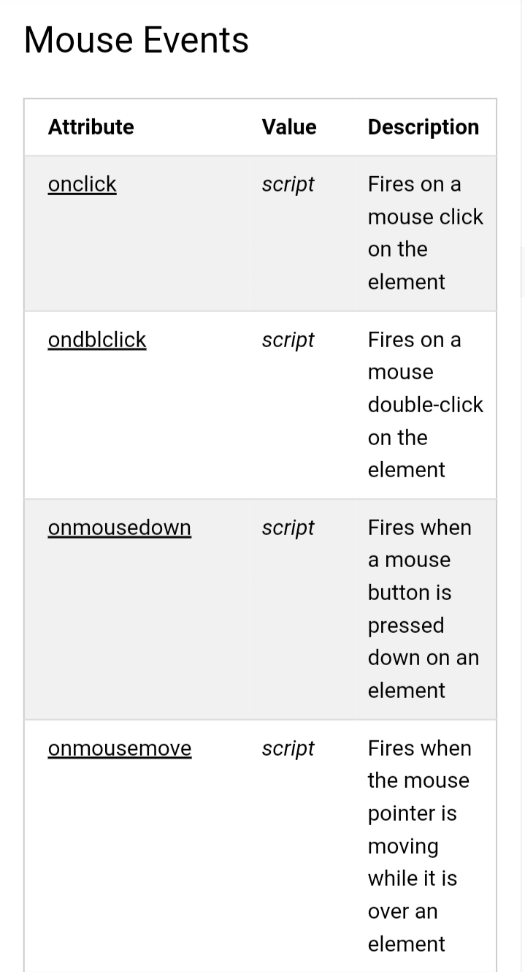

Slide 28
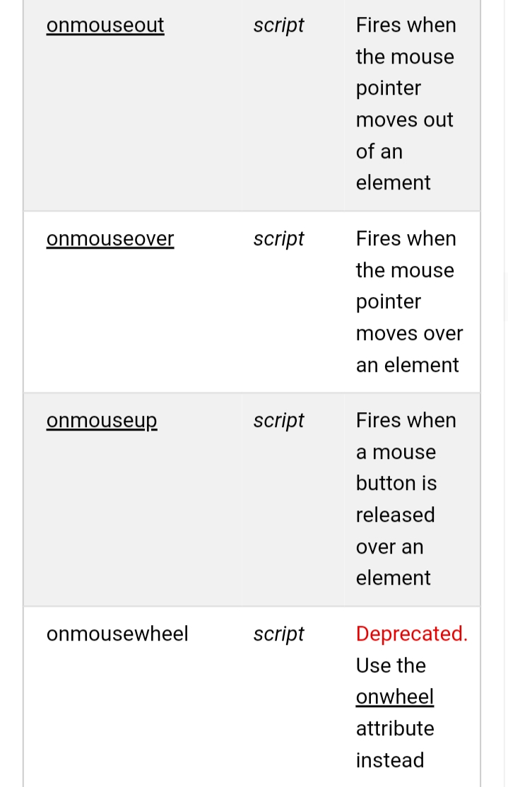

Slide 29

On dblclick

Slide 30
The ondblclick event occurs when the user double-clicks on an element.

Slide 31
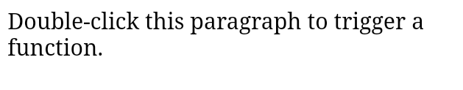
<!DOCTYPE html>
<html>
<body>
<p ondblclick="myFunction()">Double-click this paragraph to trigger a function.</p>
<p id="demo"></p>
<script>
function myFunction() {
document.getElementById("demo").innerHTML = "Hello World";
}
</script>
</body>
</html>

Slide 32

On beforeunload

Slide 33
The onbeforeunload event occurs when the document is about to be unloaded.
This event allows you to display a message in a confirmation dialog box to inform the user whether he/she wants to stay or leave the current page.
The default message that appears in the confirmation box, is different in different browsers.
However, the standard message is something like "Are you sure you want to leave this page?". This message cannot be removed.
However, you can write a custom message together with the default message. See the first example on this page. Note: This only works in Internet Explorer.
Note: If the onbeforeunload event is not assigned to the <body> element, you must assign/attach the event on the window object

Slide 34
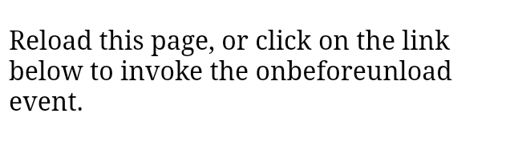
<!DOCTYPE html>
<html>
<body onbeforeunload="return myFunction()">
<p>Reload this page, or click on the link below to invoke the onbeforeunload event.</p>
<a href="https://www.wols.com">Click here to go to wools.com</a>
<script>
function myFunction() {
return "Write something clever here...";
}
</script>
</body>
</html>

Slide 35

On can play

Slide 36
The oncanplay event occurs when the browser can start playing the specified audio/video (when it has buffered enough to begin).
During the loading process of an audio/video, the following events occur, in this order:
onloadstart
ondurationchange
onloadedmetadata
onloadeddata
onprogress
oncanplay
oncanplaythrough

Slide 37
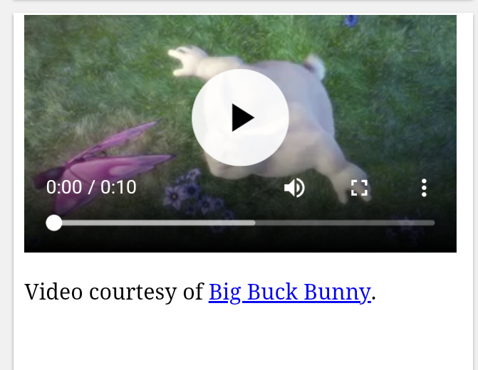
<!DOCTYPE html>
<html>
<body>
<video controls oncanplay="myFunction()">
<source src="mov_bbb.mp4" type="video/mp4">
<source src="mov_bbb.ogg" type="video/ogg">
Your browser does not support HTML5 video.
</video>
<p>Video courtesy of <a href="https://www.bigbuckbunny.org/" target="_blank">Big Buck Bunny</a>.</p>
<script>
function myFunction() {
alert("Can start playing video");
}
</script>
</body>
</html>

Slide 38
